Slide 1
Unit-5 Functions

Slide 2
Need of a Function
Knowingly or unknowingly we rely on so many persons for so many things. Man is an intelligent species, but still cannot perform all of life’s tasks all alone. He has to rely on others. For Example:
You may call a mechanic to fix up your bike, rely on a store to supply you groceries every month.
A computer program finds itself in a similar situation. It cannot handle all the tasks by itself. Instead, it requests other program like entities—called ‘functions’ in C—to get its tasks done. So now we will look at a variety of features of these functions, starting with the simplest one and then working towards those that demonstrate the power of C functions.

Slide 3
What is a Function?
In C, we can divide a large program into the basic building blocks known as function. The function contains the set of programming statements enclosed by {}. A function can be called multiple times to provide reusability and modularity to the C program. In other words, we can say that the collection of functions creates a program. The function is also known as procedure or subroutine in other programming languages.

Slide 4
For Example:
Suppose you have a task that is always performed exactly in the same way—say a bimonthly servicing of your motorbike. When you want it to be done, you go to the service station and say, “It’s time, do it now”. You don’t need to give instructions, because the mechanic knows his job. You don’t need to be told when the job is done. You assume the bike would be serviced in the usual way, the mechanic does it.
A simple C function also operates in much the same way as the mechanic. we will be look at two things—a function that calls or activates the function and the function itself.

Slide 5
Advantages of Functions
By using functions, we can avoid rewriting same logic/code again and again in a program.
We can call C functions any number of times in a program and from any place in a program.
We can track a large C program easily when it is divided into multiple functions.
Reusability is the main feature of C functions.

Slide 6
Types of Functions
There are two types of functions in C programming:
Library Functions: are the functions which are declared in the C header files such as scanf(), printf(), gets(), puts(), ceil(), floor() etc.
User-defined functions: are the functions which are created by the C programmer, so that he/she can use it many times. It reduces the complexity of a big program and optimizes the code.

Slide 7
C Library Functions
Library functions are the inbuilt function in C that are grouped and placed at a common place called the library. Such functions are used to perform some specific operations.
For example, printf is a library function used to print on the console. The library functions are created by the designers of compilers.
All C standard library functions are defined inside the different header files saved with the extension .h. We need to include these header files in our program to make use of the library functions defined in such header files.
For example, To use the library functions such as printf/scanf we need to include stdio.h in our program which is a header file that contains all the library functions regarding standard input/output.

Slide 8
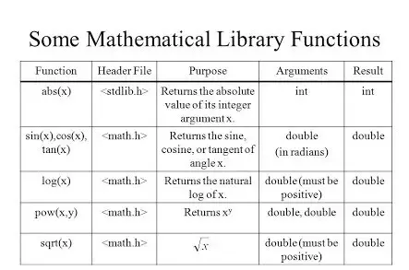
Library Functions Examples:

Slide 9
User Defined Function
C allows you to define functions according to your need. These functions are known as user-defined functions.
For example:
Suppose, you need to create a circle and color it depending upon the radius and color. You can create two functions to solve this problem:
createCircle() function
color() function

Slide 10
Example of simple user defined function:
#include<stdio.h>
void message(); // function declaration
int main()
{
printf(“Hello”);
message(); // function calling
}
void message() // function definition
{
printf(“World”);
}
Output:
Hello World

Slide 11
C User defined Function Aspects
There are 3 aspects in each C function. They are:
Function declaration
Function call
Function definition

Slide 12
Function declaration
A function must be declared globally in a C program to tell the compiler about the function name, function parameters, and return type. Function declaration is also called Function Prototyping.
The syntax of declaring a function is:
return_type function_name(data_type parameter...);

Slide 13
Function calling
Function can be called from anywhere in the program. The parameter list must watch in function calling and function declaration. We must pass the same number of functions as it is declared in the function declaration.
The syntax of calling a function is:
function_name(parameter...);

Slide 14
Function definition
It contains the actual statements which are to be executed. It is the most important aspect to which the control comes when the function is called. Here, we must notice that only one value can be returned from the function.
The syntax of defining a function is:
return_type function_name(data_type parameter...){
//code to be executed
}

Slide 15
Return Value
A C function may or may not return a value from the function. If you don't have to return any value from the function, use void for the return type.
Let's see a simple example of C function that doesn't return any value from the function.
Example without return value:
void hello(){
printf("hello C");
}
If you want to return any value from the function, you need to use any data type such as int, long, char, etc. The return type depends on the value to be returned from the function.
Example with return value:
int get(){
return 10;
}

Slide 16
Different ways of function calling
A function may or may not accept any argument. It may or may not return any value. Based on these facts, There are four different aspects of function calls.
function without arguments and without return value
function without arguments and with return value
function with arguments and without return value
function with arguments and with return value

Slide 17
Example for Function without argument and without return value
#include<stdio.h>
void printName();
int main ()
{
printf("Hello ");
printName();
return 0;
}
void printName()
{
printf(“World");
}
Output:
Hello World

Slide 18
Example for Function without arguments and with return value
#include<stdio.h>
int sum();
int main()
{
int result;
printf("\nGoing to calculate the sum of two numbers:");
result = sum();
printf("%d”,result);
return 0;
}
int sum()
{
int a, b;
printf("\nEnter two numbers");
scanf("%d %d”,&a,&b);
return a+b;
}

Slide 19
Output:
Going to calculate the sum of two numbers:
Enter two numbers
4 5
9

Slide 20
Example for Function with argument and without return value
#include<stdio.h>
void sum(int, int);
int main()
{
int a,b,result;
printf("\nGoing to calculate the sum of two numbers:");
printf("\nEnter two numbers:");
scanf("%d %d",&a,&b);
sum(a,b);
return 0;
}
void sum(int a, int b)
{
printf("\nThe sum is %d",a+b);
}

Slide 21
Output:
Going to calculate the sum of two numbers:
Enter two numbers
4 6
The sum is 10

Slide 22
Example for Function with argument and with return value
#include<stdio.h>
int sum(int, int);
int main()
{
int a,b,result;
printf("\nGoing to calculate the sum of two numbers:");
printf("\nEnter two numbers:");
scanf("%d %d",&a,&b);
result = sum(a,b);
printf("\nThe sum is : %d",result);
return 0;
}
int sum(int a, int b)
{
return a+b;
}

Slide 23
Output:
Going to calculate the sum of two numbers:
Enter two numbers
4 8
The sum is: 12

Slide 24
Actual and Formal parameters
Actual Parameters: The values/variables passed while calling a function are called actual parameters.
Formal Parameters: These are the variables written/declared in function definition/prototype, and receive their values when a call to that function is made.
The value(s) of the actual parameters are copied to formal parameters when the call to that function is made.

Slide 25
Call by value and Call by reference in C
There are two methods to pass the data into the function in C language, i.e., call by value and call by reference.
Call by value in C
In call by value method, the value of the actual parameters is copied into the formal parameters. In other words, we can say that the value of the variable is used in the function call in the call by value method.
In call by value method, we can not modify the value of the actual parameter by the formal parameter.
In call by value, different memory is allocated for actual and formal parameters since the value of the actual parameter is copied into the formal parameter.
The actual parameter is the argument which is used in the function call whereas formal parameter is the argument which is used in the function definition.

Slide 26
Example of call by value in c
#include<stdio.h>
void change(int num) {
printf("Before adding value inside function num=%d \n",num);
num=num+100;
printf("After adding value inside function num=%d \n", num);
}
int main() {
int x=100;
printf("Before function call x=%d \n", x);
change(x); //passing value in function
printf("After function call x=%d \n", x);
return 0;
}
Output:
Before function call x=100
Before adding value inside function num=100
After adding value inside function num=200
After function call x=100

Slide 27
Call by Value Example: Swapping the values of the two variables
#include <stdio.h>
void swap(int , int); //prototype of the function
int main()
{
int a = 10;
int b = 20;
printf("Before swapping the values in main a = %d, b = %d\n",a,b); //printing value of a & b in main swap(a,b);
printf("After swapping values in main a = %d, b = %d\n",a,b); //Actual parameters a = 10, b = 20
}
void swap (int a, int b)
{
int temp;
temp = a;
a=b;
b=temp;
printf("After swapping values in function a = %d, b = %d\n",a,b); // Formal parameters a = 20, b =10
}

Slide 28
Output:
Before swapping the values in main a = 10, b = 20
After swapping values in function a = 20, b = 10
After swapping values in main a = 10, b = 20

Slide 29
Call by reference in C
In call by reference, the address of the variable is passed into the function call as the actual parameter.
The value of the actual parameters can be modified by changing the formal parameters since the address of the actual parameters is passed.
In call by reference, the memory allocation is similar for both formal parameters and actual parameters. All the operations in the function are performed on the value stored at the address of the actual parameters, and the modified value gets stored at the same address.

Slide 30
Example of call by reference in C
#include <stdio.h>
void swap(int *, int *); //prototype of the function
int main()
{
int a = 10;
int b = 20;
printf("Before swapping the values in main a = %d, b = %d\n",a,b); // printing a & b in main
swap(&a,&b);
printf("After swapping values in main a = %d, b = %d\n",a,b);//Actual parameters a = 10, b = 20
}
void swap (int *a, int *b)
{
int temp;
temp = *a;
*a=*b;
*b=temp;
printf("After swapping values in function a = %d, b = %d\n",*a,*b); //Formal parameters, a = 20 b = 10
}

Slide 31
Output:
Before swapping the values in main a = 10, b = 20
After swapping values in function a = 20, b = 10
After swapping values in main a = 20, b = 10

Slide 32
Difference between call by value and call by reference
Parameters | Call by value | Call by reference
Definition | While calling a function, when you pass values by copying variables, it is known as "Call By Values." | While calling a function, in programming language instead of copying the values of variables, the address of the variables is used it is known as "Call By References.
Arguments | In this method, a copy of the variable is passed. | In this method, a variable itself is passed.
Effect | Changes made in a copy of variable never modify the value of variable outside the function. | Change in the variable also affects the value of the variable outside the function.
Alteration of value | Does not allow you to make any changes in the actual variables. | Allows you to make changes in the values of variables by using function calls.
Passing of variable | Values of variables are passed using a straightforward method. | Pointer variables are required to store the address of variables.
Value modification | Original value not modified. | The original value is modified.
Memory Location | Actual and formal arguments will be created in different memory location | Actual and formal arguments will be created in the same memory location

Slide 33
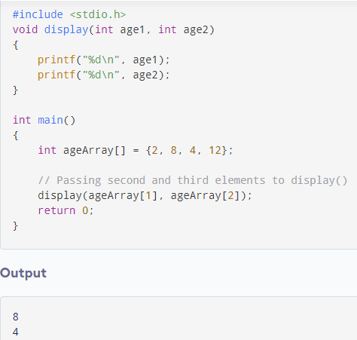
Passing Arrays to a Function
Passing array elements to a function is similar to passing variables to a function.
Example: Passing an array

Slide 34
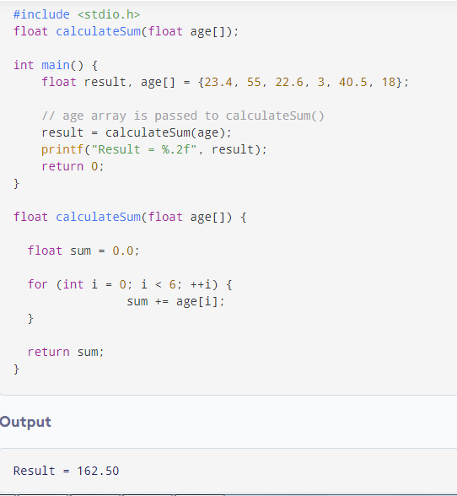
Example 2: Passing arrays to functions

